Slide 1
AI Booster – Week 02 Session 01 - Introduction
Franck JAOTOMBO & Antoine SCHERRER ascherrer@em-lyon.com
Notes:
Let me introduce myself :
Write name on the board : Franck JAOTOMBO
Double training : applied maths and management / organizational behavior
3 Masters degrees : Physics, Philosophy & Maths
1 Ph.D : Management Sciences
I have been in the training business most of my life chiefly as an entrepreneur and /or self-employed
Currently I mainly carry on three taks :
Teach in business schools
Implement statistical studies for colleagues researchers
Work as a free lance data scientist and statitiscian

Slide 2


Welcome!
Pleased to meet you !
Antoine SCHERRER
Professor of Data and Applied Maths at EM LYON
PhD in Computer science, ENS Lyon, France
4 experiences in startups (one of which is a higher ed. school)
Interested in:
Data science (with Python)
NLP
Digital transformations
Software dev
Music!
Few words about yourselves
?

Slide 3
Outline & Program
One week dedicated to improve your python programming skills and review basic statistical notions
Day 1 (today!) => Introduction, data, data cleaning
Day 2 => Univariate statistics
Day 3 => Bivariate statistics
Day 4 => Hypothesis testing and important distributions
Day 5 => Review linear algebra

Slide 4
Teaching / learning materials
Every day will follow the same schedule
1h30 of lecture (or less)
1h30 of in-class pratice (live coding session)
Afternoon dedicated to practice (Tues., Wed., Thur. With a teaching assistant)
Evaluation => individual quizz/exercices beginning of october + group project (at the end of week 3)

Slide 5
Why do we need statistics ?
General Introduction
Classification of variables

Slide 6
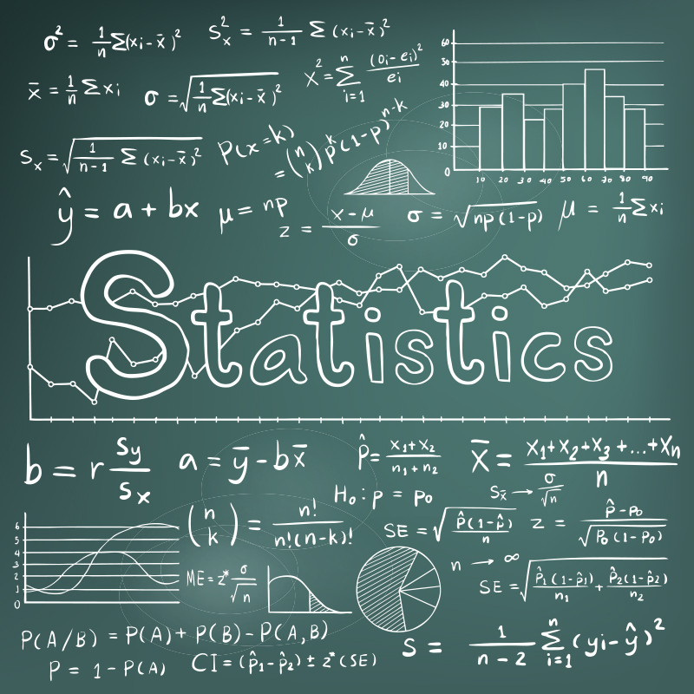
Making decision in an uncertain environment
Running an organization (leading, managing, organizing…) is mostly about making decisions
Should we launch this new product on this market ?
To make informed (wise) decisions, we need reliable information
Information is encapsulated within all sorts of data
Statistics is a tool to help process, summarize, analyze, and interpret data
In sum : statistics facilitates decision making
Another reason : this is the age of Artificial Intelligence
AI is largely based on statistics
Notes:
When we say, we live in an uncertain environment, in our lifetime this statement has never been more accurate, and descriptive of our situation… obviously
But even in the past, when things were more stable and not as fast paced, we have always lived in an uncertain environnement have we not ?
It is in a such environment that we run organizations
I think we may easily agree that running an organization is mostly about making decisions
Examples of decisions to make :
Should we invest ?
Should we downsize ?
Should we expand to a new market ?
Do we have enough return from our advertisements ?
Let’s take a concrete example.
You and the members of your board of directors have been thinking of launching a new product in a new country.
Your study shows that for your product to be profitable, you need to sell it at least 100€ per unit on average
You need to decide whether your prospects are willing to buy the product at that price
This is typically a decision that statistics can help you make
For example, you can select a sample of prospects and determine the average price they are willing to invest.
Then assuming that the minimum price is 100€/unit it is easy to determine the probability to obtain the above sample mean.
And you make your decision based on that probability.
But to make such decisions we need reliable information, and information is encapsulated within data
So Basically: Statistics is a tool to help process, summarize, analyze, and interpret data
… and make wise decisions
So did I say that Statistics helps us be wiser ?
----
But there is another reason…
This is the age of Artificial Intelligence – so all the organizations will have to deal with it one way or another
So we will be required to develop an AI culture, which I am afraid requires some knowledge about statistics…

Slide 7
Descriptive and Inferential Statistics
Two branches of statistics:
Descriptive statistics
Graphical and numerical procedures to summarize and process data
Inferential statistics
Using data to make predictions, forecasts, and estimates to assist decision making

Slide 8
Descriptive Statistics
Collect data
e.g., Survey
Present data
e.g., Tables and graphs
Summarize data
e.g., Sample mean =

Slide 9
Inferential Statistics
Estimation
e.g., Estimate the population mean weight using the sample mean weight
Hypothesis testing
e.g., Test the claim that the population mean weight is 70 kgs
Inference is the process of drawing conclusions or making decisions about a population based on sample results

Slide 10
Basic Vocabulary of Statistics
VARIABLES
Variables are characteristics of an item or individual; they are what you analyze when you use a statistical method.
DATA
Data are the different values associated with a variable.
OPERATIONAL DEFINITIONS
Data values are meaningless unless their variables have operational definitions, universally accepted meanings that are clear to all associated with an analysis.
POPULATION
A population consists of all the items or individuals about which you want to draw a conclusion. The population is the “large group”
SAMPLE
A sample is the portion of a population selected for analysis. The sample is the “small group”
PARAMETER
A parameter is a numerical measure that describes a characteristic of a population.
STATISTIC
A statistic is a numerical measure that describes a characteristic of a sample.

Slide 11
Population vs. Sample
Population
Sample
Measures used to describe the population are called parameters
Measures used to describe the sample are called statistics

Slide 12
Types of Data Analysis
Quantitative Methods (structured data)
Testing theories using numbers
Qualitative Methods (unstructured data)
Testing theories using language
Magazine articles/Interviews
Conversations
Newspapers
Media broadcasts
In this course we will address only quantitative methods.

Slide 13
What makes a data set ?
The population
The set of (all) the individual units under study
A statistical unit (or individual)
A unit of the population
Usually a line (a row) in the data set
Sample
A subset of the population (preferably representative)
Variables
What is being measured
Usually a column in the database

Slide 14
Classification of Variables
Variables
Categorical
Quantitative
Nominal
Ordinal
Discrete
Continuous
Examples:
Marital Status
Political Party
Eye Color
(Defined Categories)
Examples: Ratings
Good, Better, Best
Low, Med, High
(Ordered Categories)
Examples:
Number of Children
Defects per hour
(Counted items)
Examples:
Weight
Voltage
(Measured
characteristics)

Slide 15
Levels of Measurement
Categorical (entities are divided into distinct categories):
Binary variable: There are only two categories
e.g. dead or alive.
Nominal variable: There are more than two categories
e.g. whether someone is an omnivore, vegetarian, vegan, or fruitarian.
Ordinal variable: The same as a nominal variable but the categories have a logical order
e.g. whether people got a fail, a pass, a merit or a distinction in their exam.
Numerical (entities get a distinct score):
Interval variable: Equal intervals on the variable represent equal differences in the property being measured
e.g. the difference between 6 and 8 is equivalent to the difference between 13 and 15.
Zero value is relative
Ratio variable: The same as an interval variable, but the ratios of scores on the scale must also make sense
e.g. a score of 16 on an anxiety scale means that the person is, in reality, twice as anxious as someone scoring 8.
Zero value is absolute

Slide 16
Describing Data Numerically
Central Tendency
Shape
Spread / Dispersion

Slide 17
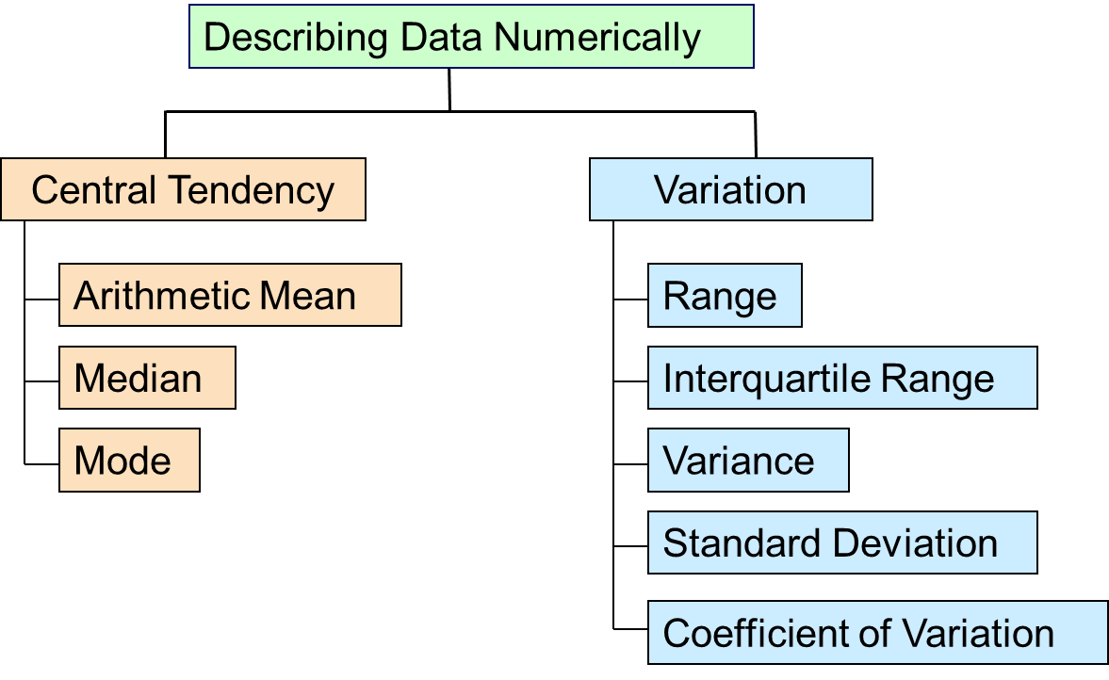

Slide 18
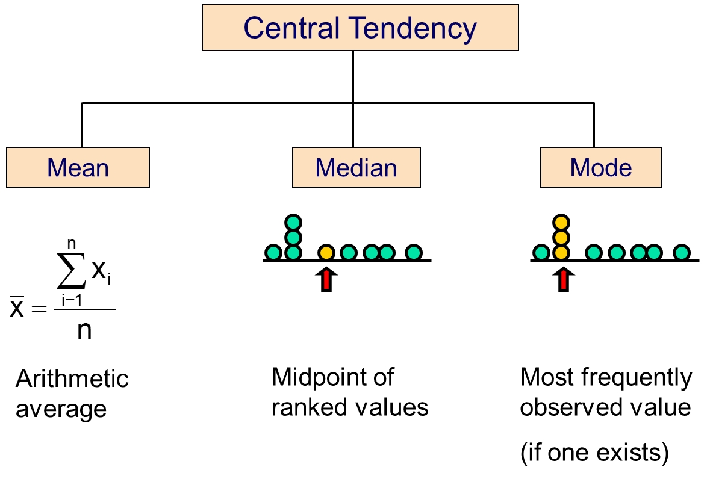
Measures of Central Tendency
The central tendency is the extent to which all the data values group around a typical or central value.
The variation (spread / dispersion) is the amount of dispersion or scattering of values
The shape is the pattern of the distribution of values from the lowest value to the highest value.

Slide 19
Arithmetic Mean
The arithmetic mean (mean) is the most common measure of central tendency
For a population of N values:
For a sample of size n:
Population values
Population size
Observed values
Sample size

Slide 20
Arithmetic Mean : example
Mean = sum of values divided by the number of values
Affected by extreme values (outliers)
0 1 2 3 4 5 6 7 8 9 10
0 1 2 3 4 5 6 7 8 9 10
Mean = 3
Mean = 4

Slide 21
Median
In an ordered list, the median is the “middle” number (50% above, 50% below)
Not affected by extreme values
0 1 2 3 4 5 6 7 8 9 10
0 1 2 3 4 5 6 7 8 9 10
Median = 3
Median = 3

Slide 22
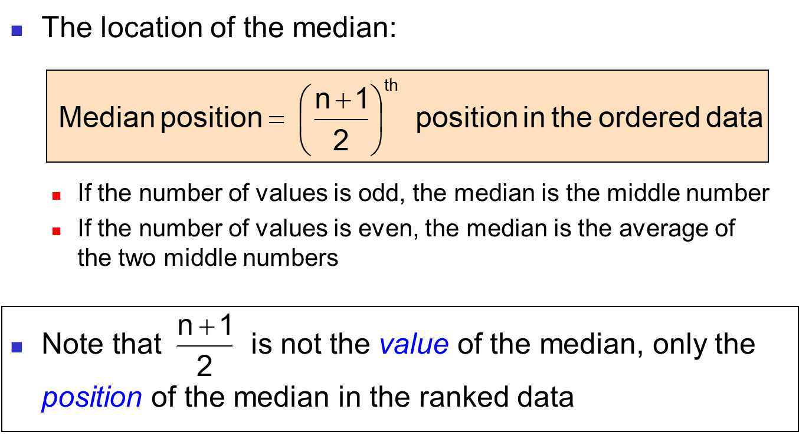
Finding the Median

Slide 23
Mode
A measure of central tendency
Value that occurs most often
Not affected by extreme values
Used for either numerical or categorical data
There may be no mode
There may be several modes
0 1 2 3 4 5 6 7 8 9 10 11 12 13 14
0 1 2 3 4 5 6
No Mode
Mode = 9

Slide 24
Example
House Prices: $2,000,000
500,000 300,000 100,000 100,000
Sum 3,000,000
Mean: ($3,000,000/5)
= $600,000
Median: middle value of ranked data = $300,000
Mode: most frequent value = $100,000

Slide 25
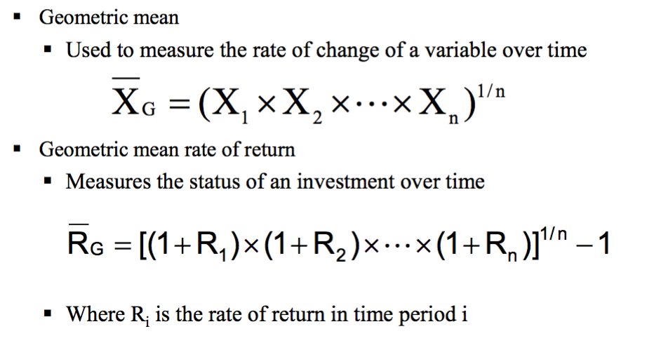
Geometric Mean

Slide 26
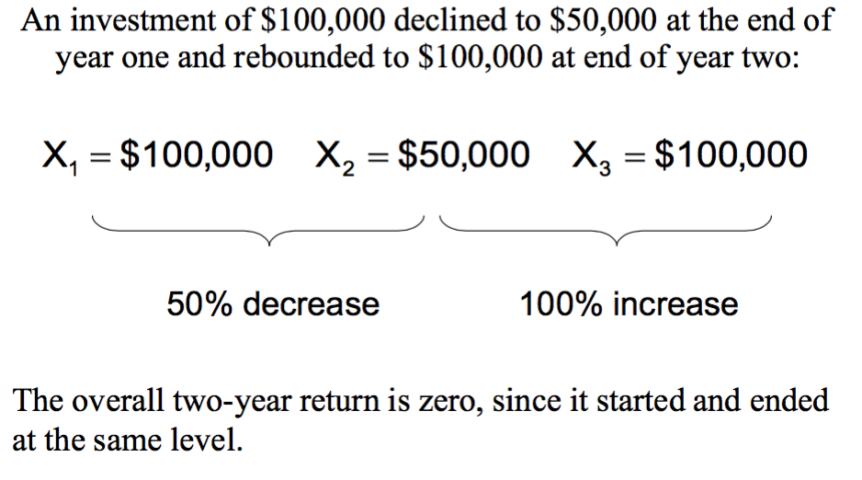
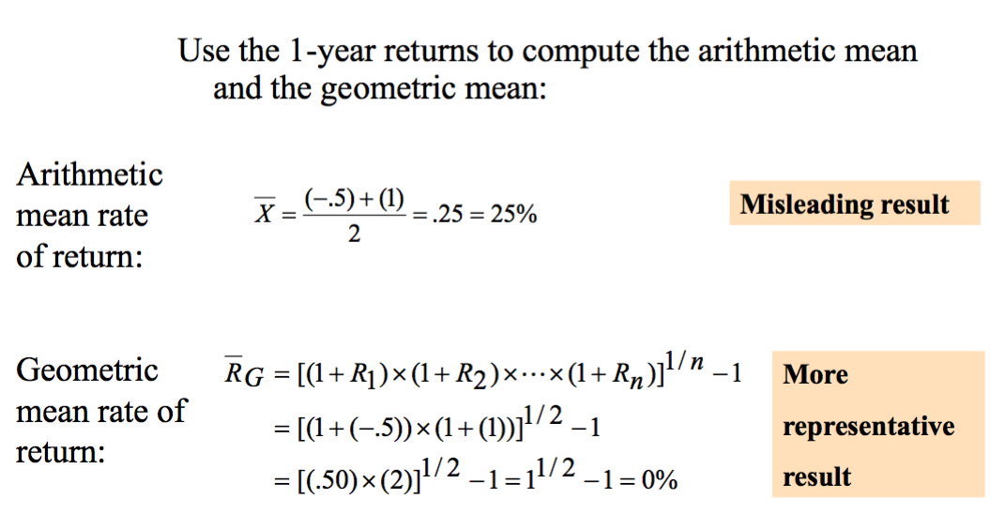
Geometric mean : example

Slide 27
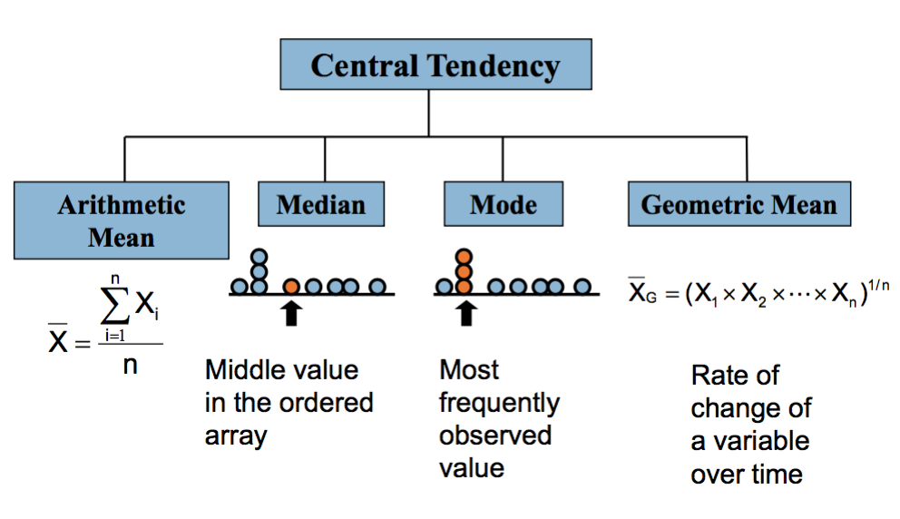
Summary : Central Tendency
The mean is generally used, unless extreme values (outliers) exist.
The median is often used, since the median is not sensitive to extreme values. For example, median home prices may be reported for a region; it is less sensitive to outliers.
In some situations it makes sense to report both the mean and the median.
Mode in the only option for categorical data

Slide 28
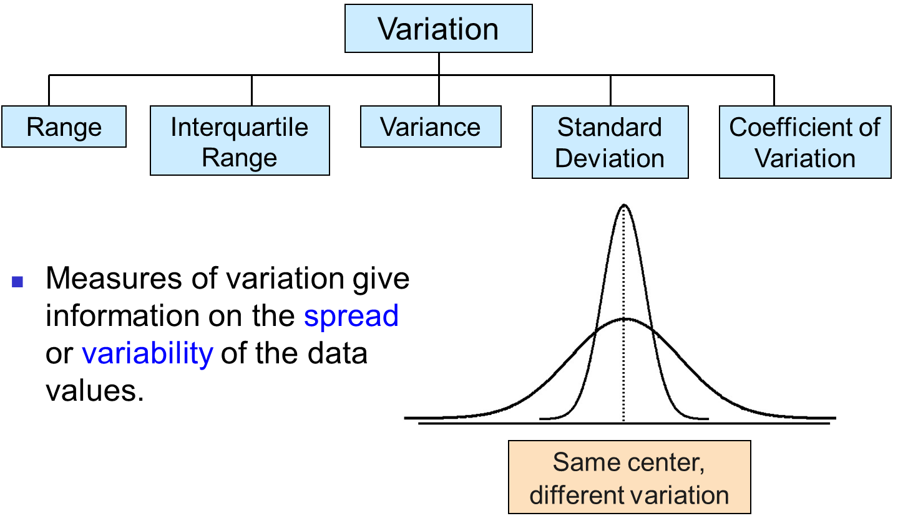
Measures of Variability / Spread / Dispersion

Slide 29
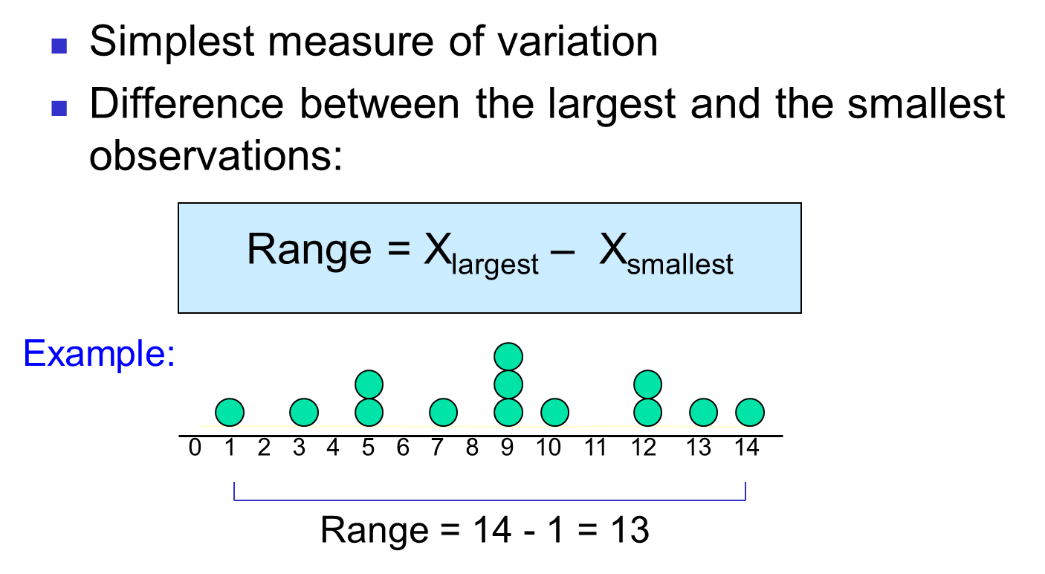
Range

Slide 30
Disadvantages of the Range
Ignores the way in which data are distributed
Sensitive to outliers
7 8 9 10 11 12
7 8 9 10 11 12
Range = 12 - 7 = 5
Range = 12 - 7 = 5
1,1,1,1,1,1,1,1,1,1,1,2,2,2,2,2,2,2,2,3,3,3,3,4,5
Range = 5 - 1 = 4
1,1,1,1,1,1,1,1,1,1,1,2,2,2,2,2,2,2,2,3,3,3,3,4,120
Range = 120 - 1 = 119

Slide 31
Interquartile Range
Can eliminate some outlier problems by using the interquartile range
Eliminate high- and low-valued observations and calculate the range of the middle 50% of the data
Interquartile range = 3rd quartile – 1st quartile
IQR = Q₃ – Q₁

Slide 32
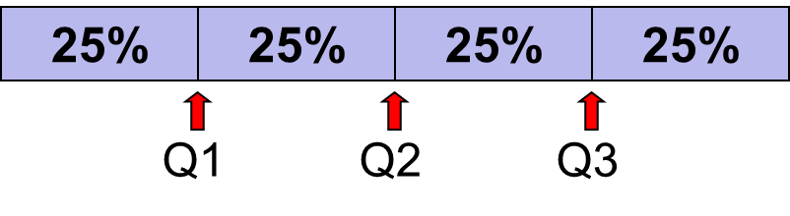
Quartile Measures
Quartiles split the ranked data into 4 segments with an equal number of values per segment
The first quartile, Q1, is the value for which 25% of the observations are smaller and 75% are larger
Q2 is the same as the median (50% of the observations are smaller and 50% are larger)
The third quartile, Q3, is the value for which 75% of the observations are smaller and 25% are larger
Find a quartile by determining the value in the appropriate position in the ranked data, where
First quartile position: Q₁ = (n+1)/4 ranked value
Second quartile position: Q₂ = (n+1)/2 ranked value
Third quartile position: Q₃ = 3(n+1)/4 ranked value
where n is the number of observed values

Slide 33
Quartiles : example
Sample Data in Ordered Array: 11 12 13 16 16 17 18 21 22
n = 9
Q₁ is in the (9+1)/4 = 2.5 position of the ranked data,
so Q₁ = position#2 + 0.5*(position#3 – position#2) = 12 + 0.5*(13-12) = 12.5
Q₂ is in the (9+1)/2 = 5th position of the ranked data,
so Q₂ = median = 16
Q₃ is in the 3(9+1)/4 = 7.5 position of the ranked data,
so Q₃ = position#7 + 0.5*(position#8 – position#7) = 18 + 0.5*(21-18) = 19.5
Q₁ and Q₃ are measures of non-central location
Q₂ = median, is a measure of central tendency

Slide 34
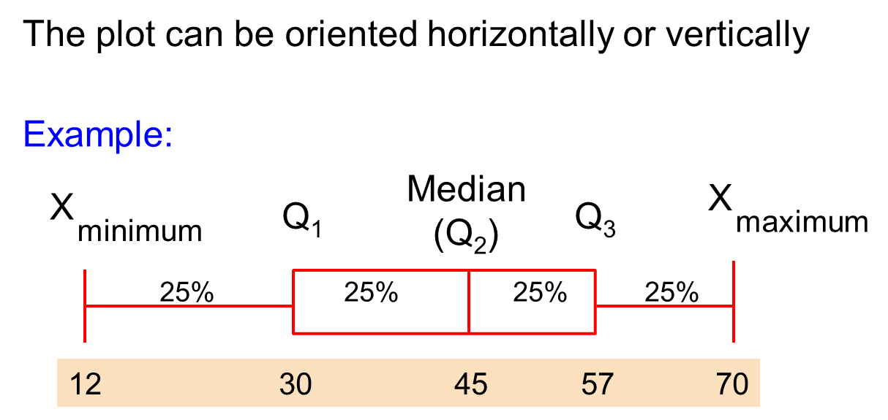
Introduction to Box-and-Whisker Plot
A box-and-whisker plot is a graph that describes the shape of a distribution
Created from the five-number summary: the minimum value, Q₁, the median, Q₃, and the maximum
The inner box shows the range from Q₁ to Q₃, with a line drawn at the median
Two “whiskers” extend from the box. One whisker is the line from Q₁ to the minimum, the other is the line from Q₃ to the maximum value

Slide 35
Constructing Full Boxplots
Draw a single vertical (or horizontal) axis spanning the range of the data. Draw short horizontal lines at the lower and upper quartiles and at the median. Then connect them with vertical lines to form a box.
Erect “fences” around the main part of the data.
The upper fence is 1.5IQRs above the upper quartile.
The lower fence is 1.5IQRs below the lower quartile.
Note: the fences only help with constructing the boxplot and should not appear in the final display.
Use the fences to grow “whiskers.”
Draw lines from the ends of the box up and down to the most extreme data values found within the fences.
If a data value falls outside one of the fences, we do not connect it with a whisker.
Add the outliers by displaying any data values beyond the fences with special symbols.
We often use a different symbol for “far outliers” that are farther than 3IQRs from the quartiles.

Slide 36
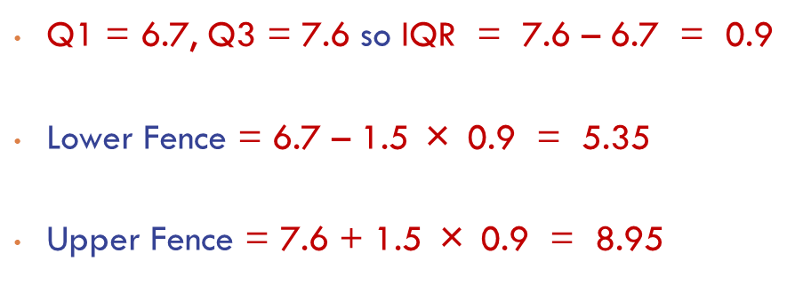
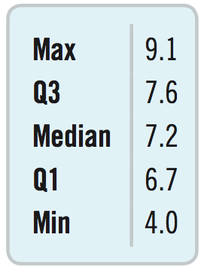
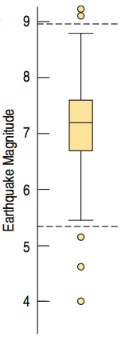
Boxplots : illustration
The smallest tsunami-causing earthquake had magnitude 4.0.
The largest tsunami-causing earthquake had magnitude 9.1.
The middle half of tsunami-causing earthquakes is between 6.7 and 7.6.
Half of tsunami-causing earthquakes have magnitudes below 7.2 and half are above 7.2.
A tsunami-causing earthquake less than 6.7 is small.
A tsunami-causing earthquake more than 7.6 is big.

Slide 37
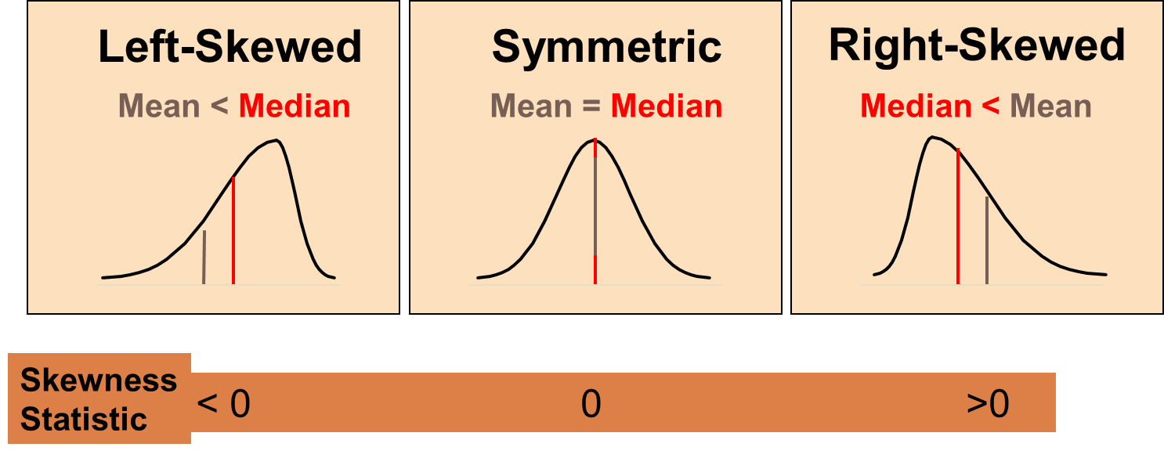
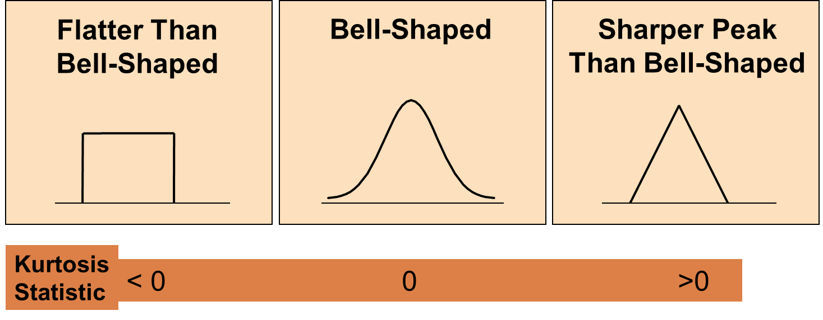
Shape of a distribution
Describes how data are distributed
Two useful shape related statistics are:
Skewness
Measures the amount of asymmetry in a distribution
Kurtosis
Measures the relative concentration of values in the center of a distribution as compared with the tails

Slide 38
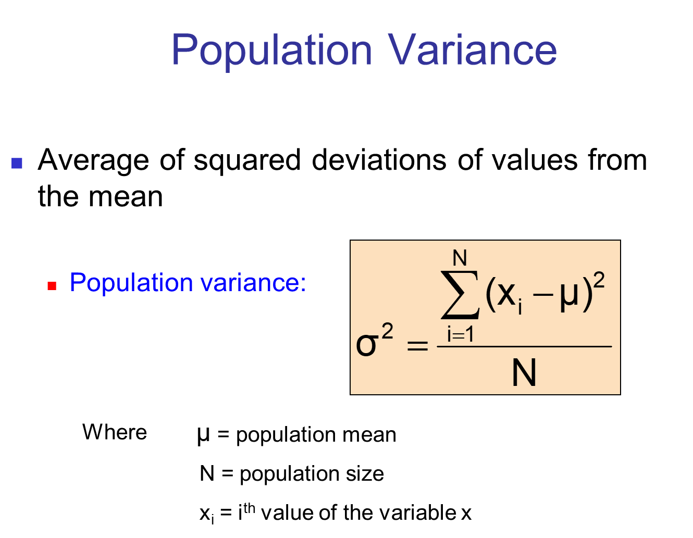
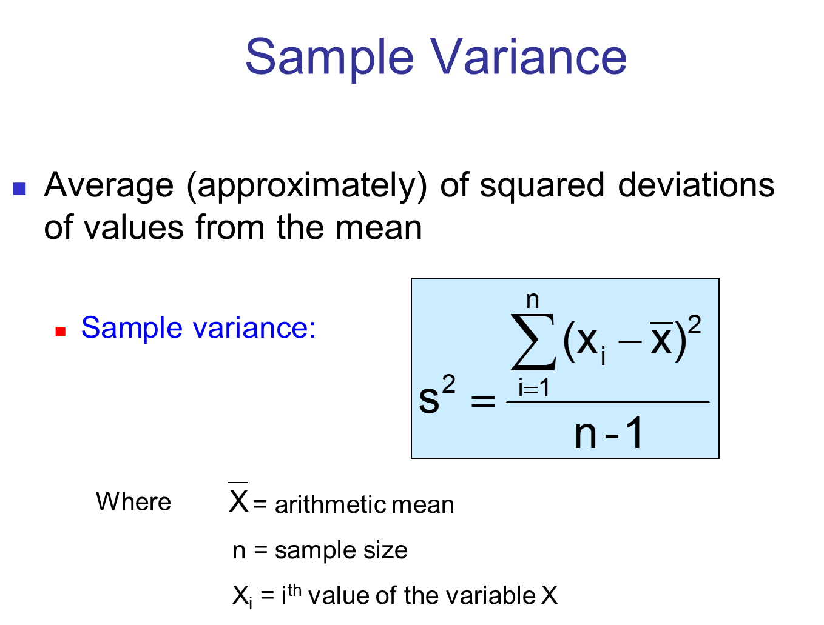
Variance

Slide 39
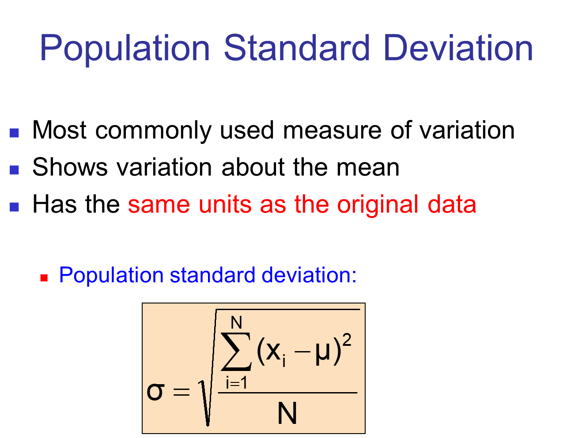
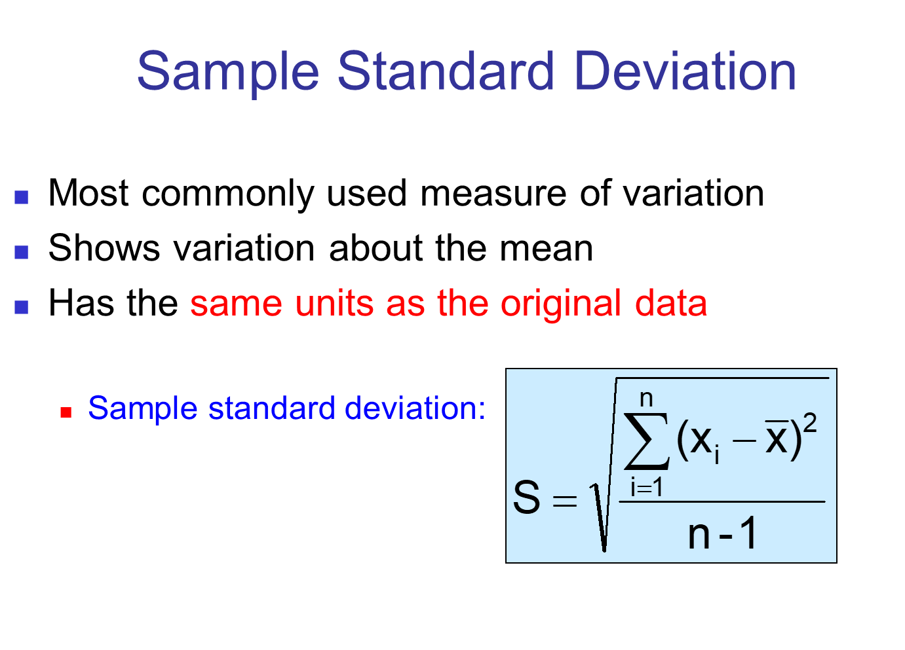
Standard Deviation

Slide 40
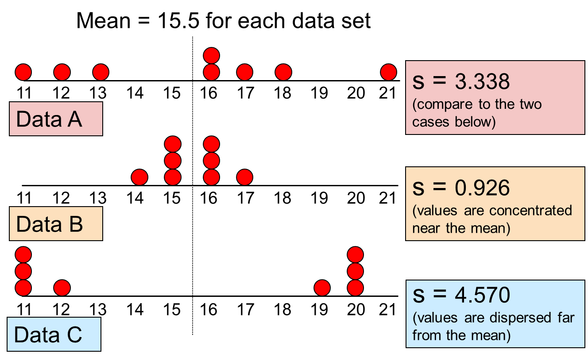
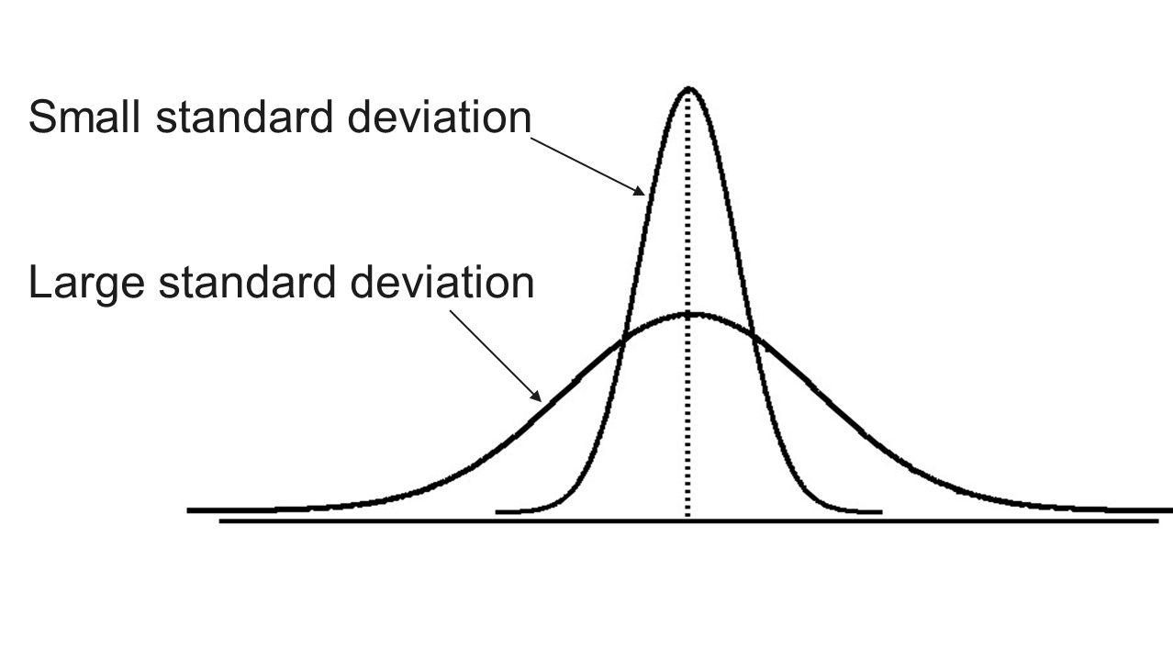
Comparing standard deviation

Slide 41
Variability : summary
The more the data are spread out, the greater the range, variance and standard deviation.
The more the data are concentrated, the smaller the range, variance and standard deviation.
If the values are all the same (no variation), all these measures will be zero.
None of these measures are ever negative.

Slide 42
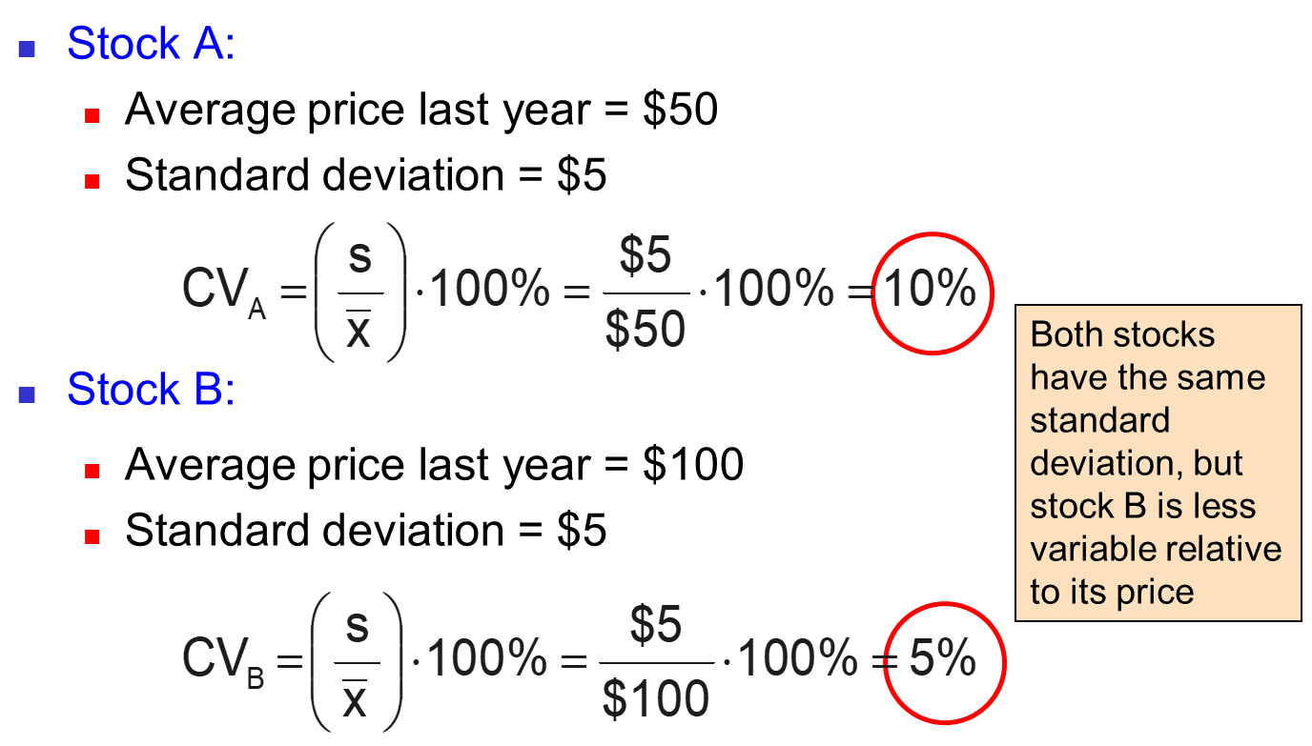
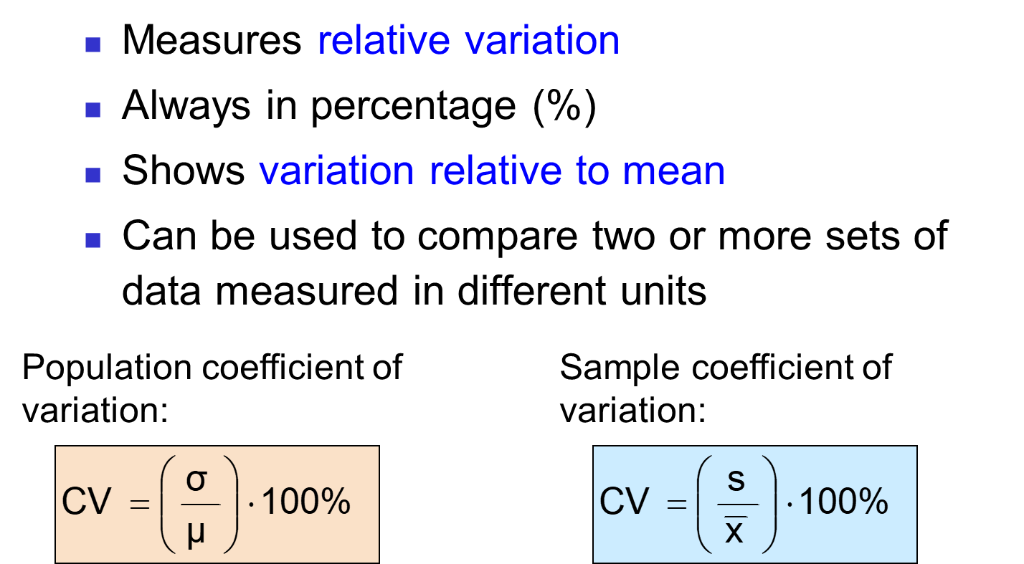
Comparing variation : Coefficient of Variation

Slide 43
Data cleaning
General Introduction
Classification of variables

Slide 44
Data cleaning
To generate meaningful, valid and reliable insights, clean, high-quality data is needed before analysis
We need to be able to reliably inform decision makers, the extent to which clean data reflects the reality of the data source - Quality decisions rely on quality data
If data is incorrect, analysis and outcomes of analysis are unreliable even though they may appear correct
Tools built using incorrect data e.g., algorithms, also become unreliable

Slide 45
Data cleaning
Any changes between the original and clean data should be recorded and reported
Steps taken in data cleaning can be used to provide feedback to improve data capture
Helps to reduce delays during analysis
Data Cleaning
Good quality data
Accurate analysis
Good Insights
Better Informed Decisions

Slide 46


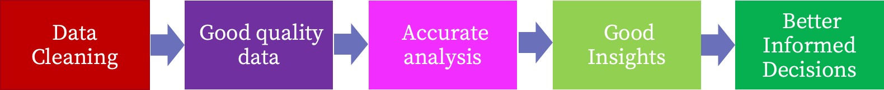

Data cleaning
Better capture reduces data cleaning labor & time
Quicker Analysis Time
Quicker decision making
Data capture
Also enhances ability to handle larger datasets
Feedback Improves Data capture

Slide 47
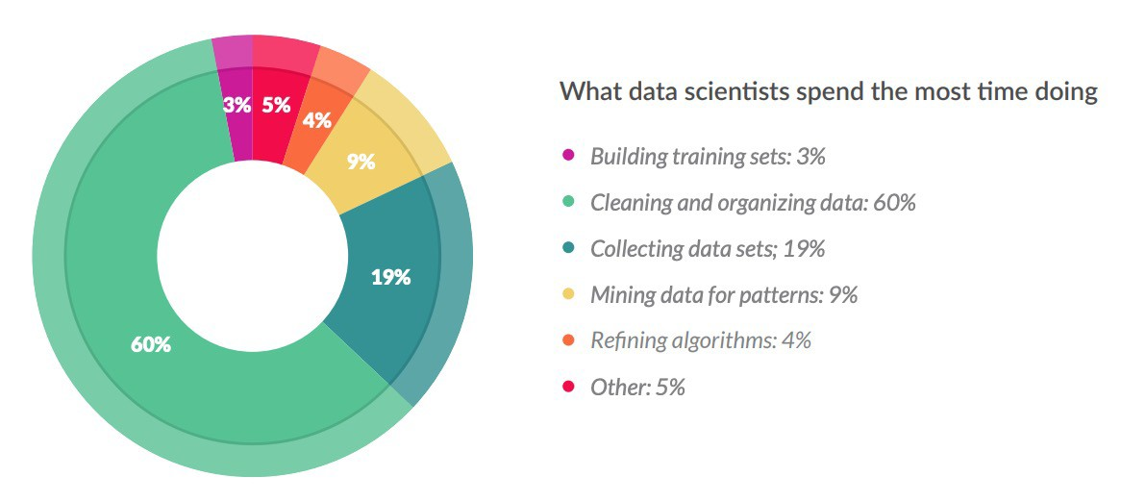
Data cleaning
https://visit.figure-eight.com/rs/416-ZBE-142/images/CrowdFlower_DataScienceReport_2016.pdf

Slide 48
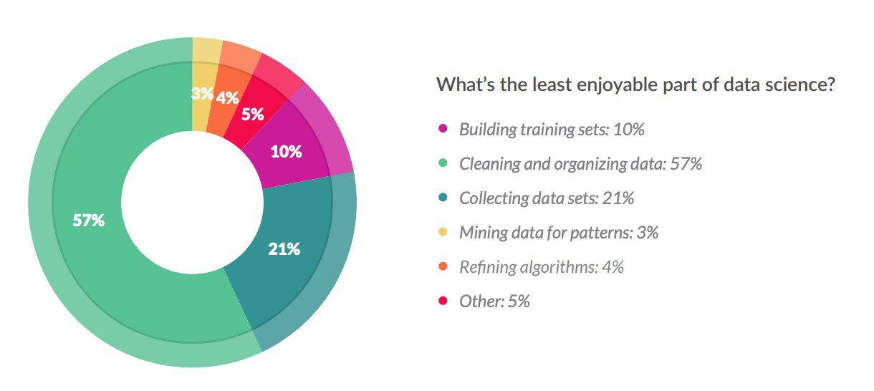
Data cleaning
… this is the least enjoyable part of data science!
https://visit.figure-eight.com/rs/416-ZBE-142/images/CrowdFlower_DataScienceReport_2016.pdf

Slide 49
Identifying irregularities in data
Broadly – steps taken in data cleaning consists of the following:
Backing up the original / master data
Data exploration: Understanding the data – its structure and dimensions
Detecting irregularities / errors in the data
Fixing the irregularities / errors in the data
Reporting your findings

Slide 50
Main kinds of irregularities
Duplicated rows
Missing values
Outliers
Spelling/typing mistakes
Useless columns (duplicated or linearly dependant)
Formating issues (. or , for fractionnal numbers, …)
Multiple values in one column
Encoding issues (utf vs latin1 vs iso

Slide 51
Any questions ? + Let’s start coding !

